Slide 1

Natural language processing
University of Crete
26 May 2021
Maria Koutsogiannaki

Slide 2
Background of the lecturer
Maria Koutsogiannaki
National technical university of Athens
Electrical & Computer Engineer
Mobile communications
University of Crete
MSc & PhD
Signal and speech processing
Machine learning
Samsung Research United Kingdom
Senior researcher
Speech modifications
Audio enhancement (Deep neural networks)
Basque Research Center of cognition Brain and Language
Postdoctoral researcher
Cognitive tasks, online auditory feedback alterations
SHERPA.AI
AI researcher
NLP (Text classification and text generation using Transformers)
2 conference
publications
Institute of Computer Science (FORTH Hellas)
European Listening Talker project (FET 7)
Toshiba Research Laboratory (1 patent)
Bequest Fellowship award
1 patent
integration on Samsung 8 Galaxy mobile phone
Marie Curie Seal of Excellence
Transformers Bert, T5
Replaced company’s traditional NLP dialogue systems (best in internal Golden competition)

Slide 3
Background of the lecturer
Maria Koutsogiannaki
< 2 years experience
National technical university of Athens
Electrical & Computer Engineer
Mobile communications
University of Crete
MSc & PhD
Signal and speech processing
Machine learning
Samsung Research United Kingdom
Senior researcher
Speech modifications
Audio enhancement (Deep neural networks)
Basque Research Center of cognition Brain and Language
Postdoctoral researcher
Cognitive tasks, online auditory feedback alterations
SHERPA.AI
AI researcher
NLP (Text classification and text generation using Transformers)
2 conference
publications
Institute of Computer Science (FORTH Hellas)
European Listening Talker project (FET 7)
Toshiba Research Laboratory (1 patent)
Bequest Fellowship award
1 patent
integration on Samsung 8 Galaxy mobile phone
Marie Curie Seal of Excellence
Transformers Bert, T5
Replaced company’s traditional NLP dialogue systems (best in internal Golden competition)

Slide 4
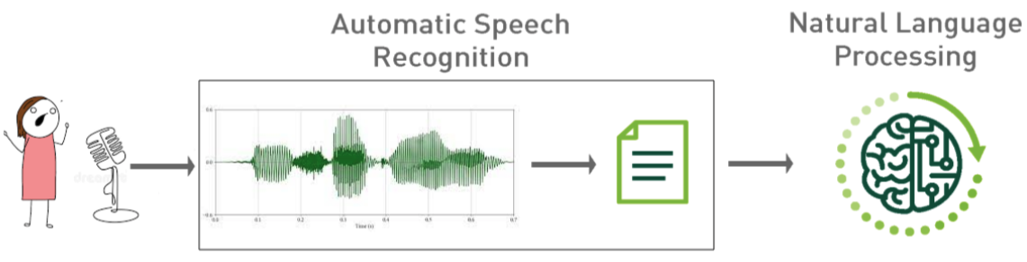
What is NLP and why is it a hot subject?
Natural language processing (NLP) is a branch of artificial intelligence that helps computers understand, interpret and manipulate human language.
Action
Text
Prediction

Slide 5
Examples of NLP - perform an Action
Action
Text
Prediction
ASR system | NLP system | Mobile System - Action
Put on an alarm at three a.m. | Domain: alarm Intent: put on Slot: time=3 time_ref = a.m. | From systems time increase time until you find 0300 and set alarm at 03.00
Tomorrow I have to wake up very early. Put an alarm at three | Domain: alarm Intent: put Slot: day = tomorrow time=3 time_ref = a.m. | From calendar see date. Increase by one day and set alarm at 0300

Slide 6
Examples of NLP - perform an Action
Action
Text
Prediction
Sounds easy?
“I have not slept for sixteen hours so don’t
you dare wake me up at three!”
“I have not slept for sixteen hours so maniana no te atreves levantarme at three!”
ASR system | NLP system | Mobile System - Action
Put on an alarm at three a.m. | Domain: alarm Intent: put on Slot: time=3 time_ref = a.m. | From systems time increase time until you find 0300 and set alarm at 03.00
Tomorrow I have to wake up very early. Put an alarm at three | Domain: alarm Intent: put Slot: day = tomorrow time=3 time_ref = a.m. | From calendar see date. Increase by one day and set alarm at 0300

Slide 7
Examples of NLP - Prediction
Action
Text
Prediction
Text review from Tripadvisor | NLP system - Classification (Aspect based sentiment analysis)
Grecocina is a great choice for informal dinners or lunch. The interior space is small but very nicely decorated The greek salad is really one of the best greek salads I’ve had. The vegetarian Mousaka is a fantastic Idea that unfortunately lacked in exexution. Some dishes were a bit too experimental for our party such as the cinnamon cream desert. But, overall everyone was Happy with their plates and I would be Happy to revisit. | Class (aspect) - value(polarity) Food - positive Price - none Quality - positive Environment - positive

Slide 8
Examples of NLP - Prediction
Action
Text
Prediction
Sounds easy?
When humans are asked to perform this task there is an 80% only of agreement
Text review from Tripadvisor | NLP system - Classification (Aspect based sentiment analysis)
Grecocina is a great choice for informal dinners or lunch. The interior space is small but very nicely decorated The greek salad is really one of the best greek salads I’ve had. The vegetarian Mousaka is a fantastic Idea that unfortunately lacked in exexution. Some dishes were a bit too experimental for our party such as the cinnamon cream desert. But, overall everyone was Happy with their plates and I would be Happy to revisit. | Class (aspect) - value(polarity) Food - positive Price - none Quality - positive Environment - positive

Slide 9
Examples of NLP - Text
Action
Text
Prediction
Text review from Tripadvisor | NLP system - Summarization
Grecocina is a great choice for informal dinners or lunch. The interior space is small but very nicely decorated The greek salad is really one of the best greek salads I’ve had. The vegetarian Mousaka is a fantastic Idea that unfortunately lacked in exexution. Some dishes were a bit too experimental for our party such as the cinnamon cream desert. But, overall everyone was Happy with their plates and I would be Happy to revisit. | Grecocina ‘s interior space is small but very nicely decorated. The greek salad is the best I’ve had but the vegetarian Mousaka lacked in exexution. Some dishes were a bit too experimental for our party but I would be Happy to revisit.

Slide 10
Examples of NLP - Text
Action
Text
Prediction
Text review from Tripadvisor | NLP system -Translation
Grecocina is a great choice for informal dinners or lunch. The interior space is small but very nicely decorated The greek salad is really one of the best greek salads I’ve had. The vegetarian Mousaka is a fantastic Idea that unfortunately lacked in exexution. Some dishes were a bit too experimental for our party such as the cinnamon cream desert. But, overall everyone was Happy with their plates and I would be Happy to revisit. | Η Grecocina είναι μια εξαιρετική επιλογή για ανεπίσημα δείπνα ή μεσημεριανό γεύμα. Ο εσωτερικός χώρος είναι μικρός αλλά πολύ όμορφα διακοσμημένος Η ελληνική σαλάτα είναι πραγματικά μια από τις καλύτερες ελληνικές σαλάτες που είχα. Η χορτοφάγος Μουσάκα είναι μια φανταστική ιδέα που δυστυχώς δεν έλειπε. Μερικά πιάτα ήταν λίγο πολύ πειραματικά για το πάρτι μας, όπως η έρημος με κρέμα κανέλας. Όμως, γενικά όλοι ήταν ευχαριστημένοι με τα πιάτα τους και θα ήμουν ευτυχής να το ξαναδώ.

Slide 11
Examples of NLP - translate/summarize/generate
Action
Text
Prediction
Text - table | NLP system - Generation
 | Grecocina is a great choice for informal dinners or lunch. The interior space is small but very nicely decorated The greek salad is really one of the best greek salads I’ve had. The vegetarian Mousaka is a fantastic Idea that unfortunately lacked in exexution. Some dishes were a bit too experimental for our party such as the cinnamon cream desert. But, overall everyone was Happy with their plates and I would be Happy to revisit.
Name | Type | Quality | Ambient | Overall
Grecocina | lunch dinner informal | salad: excellent musaka: medium | small mice decoration | positive

Slide 12
NLP examples overview
Text summarization (extractive, abstractive)
Intent-slot detection
Sentiment analysis
Data-to-text generation
Logic inference: learn a model to perform mathematical operations
Named-entity recognition

Slide 13
Difficulty of NLP
NLP is a difficult task because human language is complex
language variety
word ambiguities
complex concepts
multiple domains with different terminology (scientific, politics, economics, etc)
culture, background etc. aspects (sarcasm, humor, slang etc.)

Slide 14
Clients
automatic voice assistants: chatbox, voice systems e.g. alexa, call centers
reviews from internet (movies, restaurants, political aspects, and more!)
recommendations (behavioral analysis from social media)
translation systems
All that has to do with human language understanding!!

Slide 15
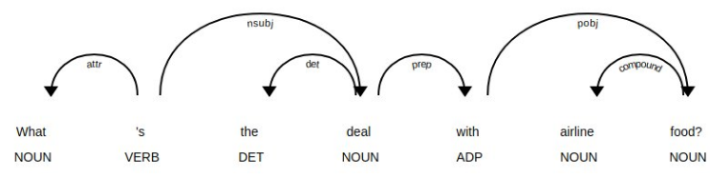
How did we do it?
Rule-based approaches
old method
focus on pattern-matching or parsing
can often be thought of as "fill in the blanks" method
high performance in specific use cases
suffer performance degradation when generalized

Slide 16
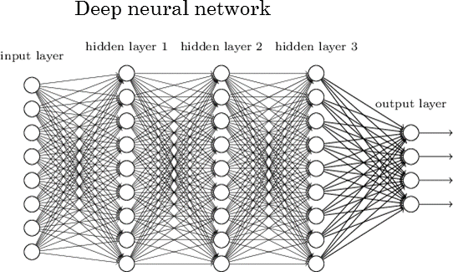
How do we do it?
Deep neural models for language understanding

Slide 17
Sentiment analysis task - hands on!
Perform sentiment analysis
Select a dataset
Create a model
Train the model
Evaluate the model
Perform prediction: for an input text decide if positive or negative
Text review from Tripadvisor | NLP system - Classification (Aspect based sentiment analysis)
Grecocina is a great choice for informal dinners or lunch. The interior space is small but very nicely decorated The greek salad is really one of the best greek salads I’ve had. The vegetarian Mousaka is a fantastic Idea that unfortunately lacked in exexution. Some dishes were a bit too experimental for our party such as the cinnamon cream desert. But, overall everyone was Happy with their plates and I would be Happy to revisit. | Class (aspect) - value(polarity) Food - positive Price - none Quality - positive Environment - positive
positive/negative

Slide 18
Sentiment analysis task - hands on!
Perform sentiment analysis
Select a dataset
Create a model
Train the model
Evaluate the model → select a benchmark dataset
Perform prediction: for an input text decide if positive or negative
Text review from Tripadvisor | NLP system - Classification (Aspect based sentiment analysis)
Grecocina is a great choice for informal dinners or lunch. The interior space is small but very nicely decorated The greek salad is really one of the best greek salads I’ve had. The vegetarian Mousaka is a fantastic Idea that unfortunately lacked in exexution. Some dishes were a bit too experimental for our party such as the cinnamon cream desert. But, overall everyone was Happy with their plates and I would be Happy to revisit. | Class (aspect) - value(polarity) Food - positive Price - none Quality - positive Environment - positive
positive/negative

Slide 19
Sentiment analysis task - imdb movie reviews
Benchmark dataset - https://gluebenchmark.com/leaderboard
Movie reviews classified on positive or negative by human annotators
Imdb review examples | Prediction
This was absolutely one of the best movies I have seen. <br/><br/>. Excellent performances from a marvelous A-list cast that will move you from smiles to laughter to tears and back. <br/><br/>. Take the time to watch it! I only went to see the movie because I have always liked Kevin Costner. I felt that Ashtin did a great job in the Butterfly effect. Unfortunately, even though these two actores are cabable of good if not great acting moments some of that was missing. Some of the scenes were not just believable and didn’t have enough story line support. Though the movie claims influence from the Hurricane Kaatrina aftermath, there was very little (none) to that effect in the movie. Overall, I liked the fact that the move brought forward some of what goes into saving lives from a water perspective. The special effects were pretty good and more than intimidating, Not sure I will ever go deep fishing again. I expected a little more emotion in the film than what was presented. Definitely a movie that could have been seen on DVD | ? ?

Slide 20
Sentiment analysis task - imdb movie reviews
Benchmark dataset - https://gluebenchmark.com/leaderboard
Movie reviews classified on positive or negative by human annotators
Imdb review examples | Prediction
This was absolutely one of the best movies I have seen. <br/><br/>. Excellent performances from a marvelous A-list cast that will move you from smiles to laughter to tears and back. <br/><br/>. Take the time to watch it! I only went to see the movie because I have always liked Kevin Costner. I felt that Ashtin did a great job in the Butterfly effect. Unfortunately, even though these two actores are cabable of good if not great acting moments some of that was missing. Some of the scenes were not just believable and didn’t have enough story line support. Though the movie claims influence from the Hurricane Kaatrina aftermath, there was very little (none) to that effect in the movie. Overall, I liked the fact that the move brought forward some of what goes into saving lives from a water perspective. The special effects were pretty good and more than intimidating, Not sure I will ever go deep fishing again. I expected a little more emotion in the film than what was presented. Definitely a movie that could have been seen on DVD | Positive Positive

Slide 21
Creating a model to recognise sentiments (text)
Complete the graph :)
INPUT
OUTPUT
This
was
the
best
movie
I
‘ve
seen

Slide 22

Creating a model to recognise sentiments (text)
Complete the graph :)
INPUT
OUTPUT
This
was
the
best
movie
I
‘ve
seen
Polarity: positive/negative

Slide 23
Creating a model to recognise sentiments (text)
How will a computational network
recognise text letters?
Complete the graph :)
INPUT
OUTPUT
This
was
the
best
movie
I
‘ve
seen
Polarity: positive/negative

Slide 24
Creating a model to recognise sentiments (text)
How will a computational network
recognise text letters?
Complete the graph :)
INPUT
OUTPUT
This
was
the
best
movie
I
‘ve
seen
102
10
20
118
127
118
111
580
0/1
Polarity: positive/negative

Slide 25
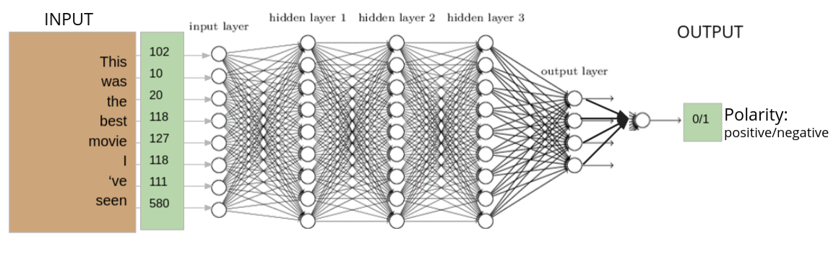
Creating a model to recognise sentiments (text)
INPUT
we have the dataset (open-source benchmark)
we know the tricks: transform text to integers
we can find a deep neural network model from the many…
Great!

Slide 26
Creating a model to recognise sentiments (text)
INPUT
we have the dataset (open-source benchmark)
we know the tricks: transform text to integers
we can find a deep neural network model from the many…
Great!
Well not yet!!
Are we going to assign
the integers randomly??

Slide 27
The idea of word-embeddings
Instead of representing the word as an integer represent it as a vector
The vector depends on the context of the word. Similar words have vectors that are “near”
Vectors are learned within the network or pre-learned by other networks
Sex
man: 1
boy: 2
male: 52
female: 88
woman: 100
girl: 101
Age
man: 1
woman: 2
male: 52
female: 88
boy: 100
girl: 101
man, woman, boy
girl, female, male
1, 2, 52, 88, 100, 101
Task: assign numbers to the words based on their context similarity

Slide 28
The idea of word-embeddings
Instead of representing the word as an integer represent it as a vector
The vector depends on the context of the word. Similar words have vectors that are “near”
Vectors are learned within the network or pre-learned by other networks
Gender Age
man: [ 1 40 ]
boy: [ 2 8 ]
male: [ 3 24 ]
female: [ 99 25 ]
woman:[ 100 41 ]
girl: [ 101 9 ]
man, woman, boy
girl, female, male
Age
woman man
female male
girl boy
Gender
Task: assign
vectors to the words based on their context similarity

Slide 29
The idea of word-embeddings
Instead of representing the word as an integer, represent it as a vector
The vector depends on the context of the word. Similar context-words have vectors that are “near”
Vectors are learned within the network or pre-learned by other networks
Gender Age Species
man: [ 1 40 300 ]
boy: [ 2 8 301 ]
male: [ 3 24 302 ]
female: [ 99 25 303 ]
woman:[ 100 41 304 ]
girl: [ 101 9 303 ]
cow: [ 102 42 1 ]
bull: [ 4 39 2 ]
man, woman, boy
girl, female, male
Age
woman man
female male
girl boy
species
Gender
Task: assign
vectors to the words based on their context similarity
cow
bull

Slide 30
The idea of word-embeddings
Instead of representing the word as an integer, represent it as a vector
The vector depends on the context of the word. Similar context-words have vectors that are “near”
Vectors are learned within the network or pre-learned by other networks
Gender Age Species
man: [ 1 40 300 ]
boy: [ 2 8 301 ]
male: [ 3 24 302 ]
female: [ 99 25 303 ]
woman:[ 100 41 304 ]
girl: [ 101 9 303 ]
cow: [ 102 42 1 ]
bull: [ 4 39 2 ]
man, woman, boy
girl, female, male
Age
woman man
female male
girl boy
species
Gender
Task: assign
vectors to the words based on their context similarity
cow
bull

Slide 31
The idea of word-embeddings
Instead of representing the word as an integer, represent it as a vector
The vector depends on the context of the word. Similar context-words have vectors that are “near”
Vectors are learned within the network or pre-learned by other networks
Gender Age Species
man: [ 1 40 300 ]
boy: [ 2 8 301 ]
male: [ 3 24 302 ]
female: [ 99 25 303 ]
woman:[ 100 41 304 ]
girl: [ 101 9 303 ]
cow: [ 102 42 1 ]
bull: [ 4 39 2 ]
man, woman, boy
girl, female, male
Age
woman man
female male
girl boy
species
Gender
Task: assign
vectors to the words based on their context similarity
cow
bull
TF-IDF: word frequency in a text considering also the entire corpus
Word2vec
Glove
https://machinelearninginterview.com/topics/natural-language-processing/what-is-the-difference-between-word2vec-and-glove/

Slide 32
The idea of word-embeddings
Instead of representing the word as an integer, represent it as a vector
The vector depends on the context of the word. Similar context-words have vectors that are “near”
Vectors are learned within the network or pre-learned by other networks
Gender Age Species
man: [ 1 40 300 ]
boy: [ 2 8 301 ]
male: [ 3 24 302 ]
female: [ 99 25 303 ]
woman:[ 100 41 304 ]
girl: [ 101 9 303 ]
cow: [ 102 42 1 ]
bull: [ 4 39 2 ]
man, woman, boy
girl, female, male
Age
woman man
female male
girl boy
species
Gender
Task: assign
vectors to the words based on their context similarity
cow
bull
Embedding layer

Slide 33
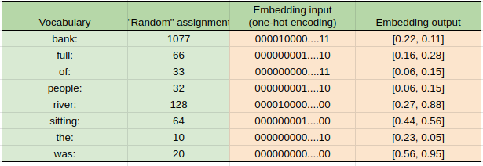
Word embedding layer
Create a vocabulary of your task
Assign randomly an integer
Create a one-hot encoding
Pass it to the first NN layer
The output of the first hidden layer is the embedding vector
Vocabulary = {bank, full, of, people, river, sitting, the, was}
Vocabulary size = 8
Embedding = 8xM, where M the size of my dimension (space) e.g M=2

Slide 34
Word embedding layer
Create a vocabulary of your task
Assign randomly an integer
Create a one-hot encoding
Pass it to the first NN layer
The output of the first hidden layer is the embedding vector
Vocabulary = {bank, full, of, people, river, sitting, the, was}
Vocabulary size = 8
Embedding = 8xM, where M the size of my dimension (space) e.g M=2

Slide 35
Word embedding layer
Create a vocabulary of your task
Assign randomly an integer
Create a one-hot encoding
Pass it to the first NN layer
The output of the first hidden layer is the embedding vector
Vocabulary = {bank, full, of, people, river, sitting, the, was}
Vocabulary size = 8
Embedding = 8xM, where M the size of my dimension (space) e.g M=2

Slide 36
Word embedding layer
Create a vocabulary of your task
Assign randomly an integer
Create a one-hot encoding
Pass it to the first NN layer
The output of the first hidden layer is the embedding vector
Vocabulary = {bank, full, of, people, river, sitting, the, was}
Vocabulary size = 8
Embedding = 8xM, where M the size of my dimension (space) e.g M=2
sentence not vocabulary:
the river was full of people
sitting in the bank

Slide 37
M1: the river was full of people
sitting in the bank
M2: the river was full
M1: the river was full of people
sitting in the bank
M1: 10 128 20 66 33 32 64 0 10 1077
M2: the bank was full
M2: 10 1077 20 66
One-hot encoding
10 128 20 66 33 32 64 0 10 1077
10 1077 20 66 0 0 0 0 0 0
index: 1 … 10 … 20… 32 33 .. 64 … 66.. 128 .. 1077 …
0 1 1 1 1 1 1 1 1
0 1 1 0 0 0 1 0 1
M = [
]
M = [
]

Slide 38
M1: the river was full of people
sitting in the bank
M2: the river was full
M1: the river was full of people
sitting in the bank
M1: 10 128 20 66 33 32 64 0 10 1077
M2: the bank was full
M2: 10 1077 20 66
One-hot encoding
10 128 20 66 33 32 64 0 10 1077
10 1077 20 66 0 0 0 0 0 0
index: 1 … 10 … 20… 32 33 .. 64 … 66.. 128 .. 1077 …
0 1 1 1 1 1 1 1 1
0 1 1 0 0 0 1 0 1
M = [
]
M = [
]
tf = number of times the 10 (the) appears in the document
idf = number of total documents/ number of documents the term appears
tfidf is high for non common words

Slide 39
Wrapping up:
Sentiment classification task: for each movie review find if it is positive or negative
INPUT
OUTPUT
This
was
the
best
movie
I
‘ve
seen
102
10
20
118
127
118
111
580
0/1
Polarity: positive/negative

Slide 40
Wrapping up:
Sentiment classification task: for each movie review find if it is positive or negative
Text representation and
embedding
INPUT
OUTPUT
This
was
the
best
movie
I
‘ve
seen
102
10
20
118
127
118
111
580
0/1
Polarity: positive/negative

Slide 41
Wrapping up:
Sentiment classification task: for each movie review find if it is positive or negative
Text representation and
embedding
Which DNN architecture?
INPUT
OUTPUT
This
was
the
best
movie
I
‘ve
seen
102
10
20
118
127
118
111
580
0/1
Polarity: positive/negative

Slide 42
Wrapping up:
CNN
RNN
Transformers
Many...
Sentiment classification task: for each movie review find if it is positive or negative
Text representation and
embedding
Which DNN architecture?
INPUT
OUTPUT
This
was
the
best
movie
I
‘ve
seen
102
10
20
118
127
118
111
580
0/1
Polarity: positive/negative

Slide 43
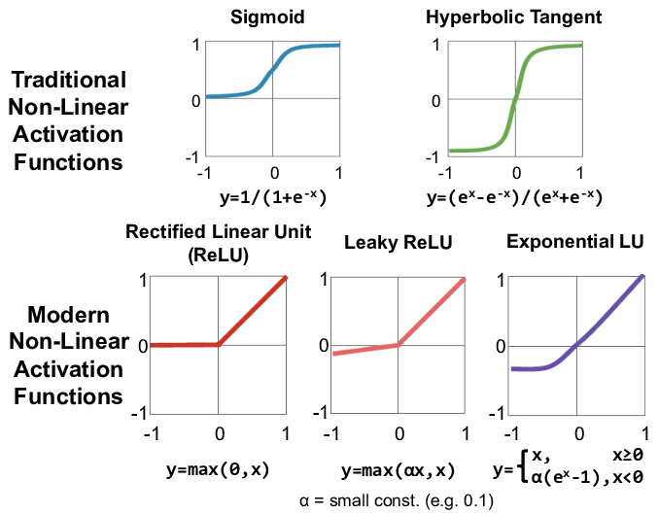
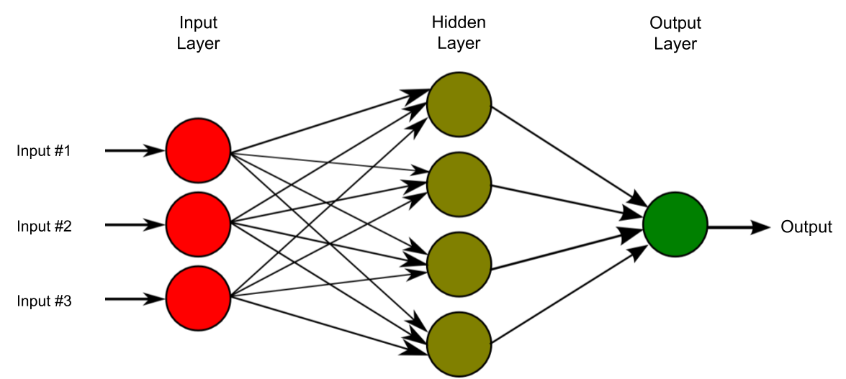
A very simple architecture: Multi-layer Perceptron
From wikipedia: MLP consists of at least three layers of nodes: an input layer, a hidden layer and an output layer. Except for the input nodes, each node is a neuron that uses a nonlinear activation function. MLP utilizes a supervised learning technique called backpropagation for training.Its multiple layers and non-linear activation distinguish MLP from a linear perceptron. It can distinguish data that is not linearly separable.
Notes:
https://allcloud.io/blog/how-to-solve-underfitting-and-overfitting-data-models/

Slide 44
A very simple architecture: Multi-layer Perceptron
From wikipedia: MLP consists of at least three layers of nodes: an input layer, a hidden layer and an output layer. Except for the input nodes, each node is a neuron that uses a nonlinear activation function. MLP utilizes a supervised learning technique called backpropagation for training.Its multiple layers and non-linear activation distinguish MLP from a linear perceptron. It can distinguish data that is not linearly separable.
Notes:
https://allcloud.io/blog/how-to-solve-underfitting-and-overfitting-data-models/

Slide 45
A very simple architecture: Multi-layer Perceptron
The error (true label - estimated
prediction) is propagated backwards
to all nodes and the weights of each node are “corrected” (updated)
to minimize the loss
https://www.youtube.com/watch?v=dB-u77Y5a6A&ab_channel=MichiganOnline
From wikipedia: MLP consists of at least three layers of nodes: an input layer, a hidden layer and an output layer. Except for the input nodes, each node is a neuron that uses a nonlinear activation function. MLP utilizes a supervised learning technique called backpropagation for training.Its multiple layers and non-linear activation distinguish MLP from a linear perceptron. It can distinguish data that is not linearly separable.
Notes:
https://allcloud.io/blog/how-to-solve-underfitting-and-overfitting-data-models/

Slide 46

Yeap time for hands on!!

Slide 47
Natural language processing
University of Crete
28 May 2021
Maria Koutsogiannaki

Slide 48
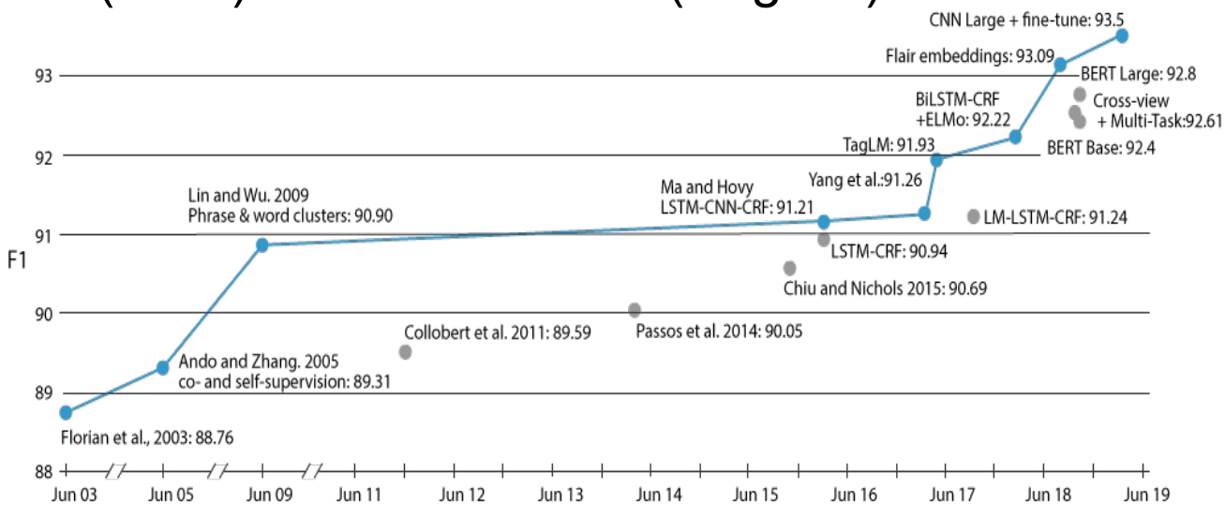
Transfer learning.. the breakthrough in NLP
Transformers
Deep learning for NLP (8th edition) https://ixa2.si.ehu.eus/deep_learning_seminar/

Slide 49
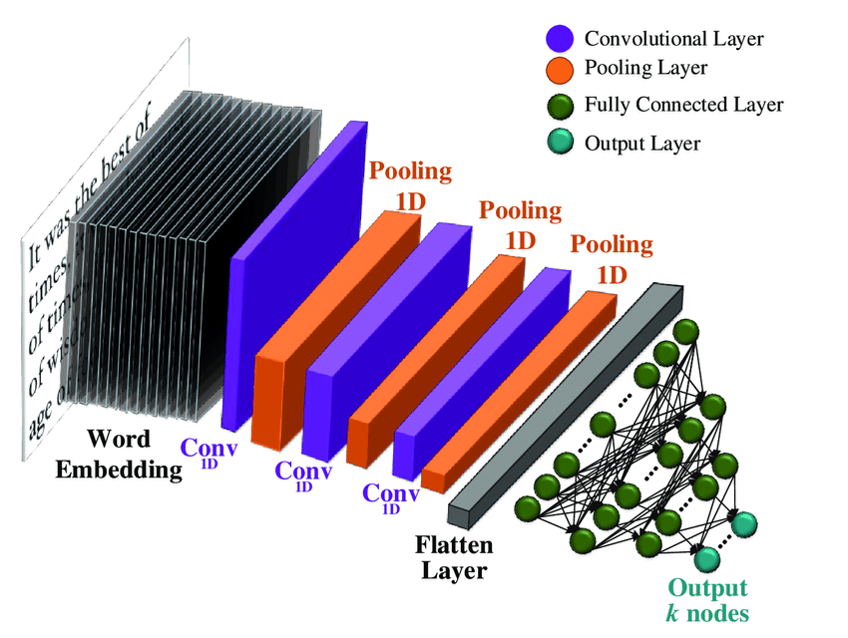
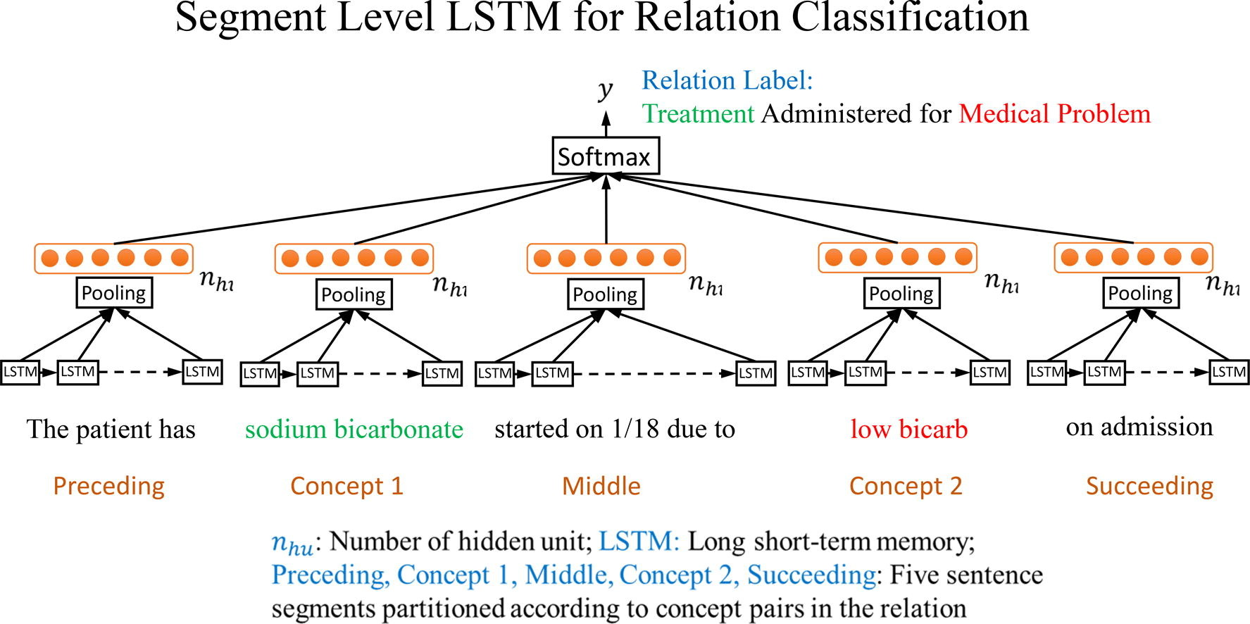
Transformers vs. CNN / RNN
CNN: convolutional neural networks Recurrent neural network

Slide 50
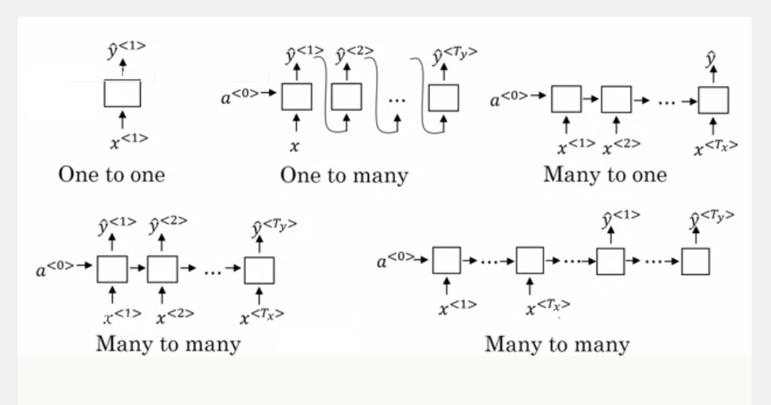
Problem
RNN are better for sequences
compared to CNN
But tend to “forget”
for long sequences

Slide 51
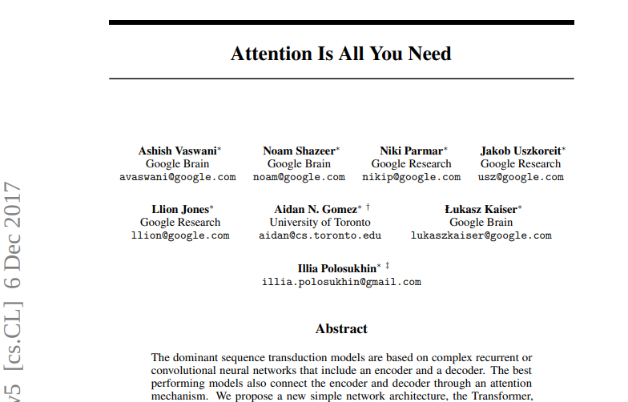
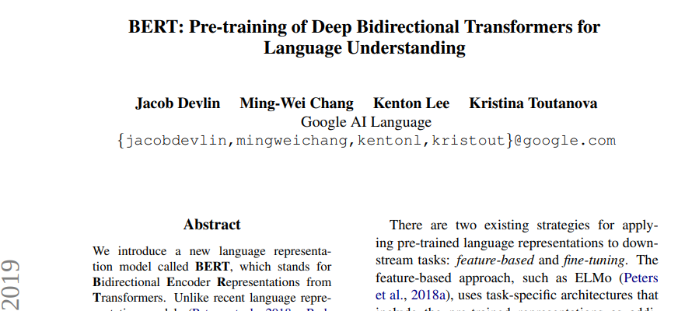
Attention, Transformers and Transfer Learning

Slide 52
BERT model
Understand what is transformer, attention and transfer learning through BERT model
Sentiment analysis example
User-system dialogue example

Slide 53
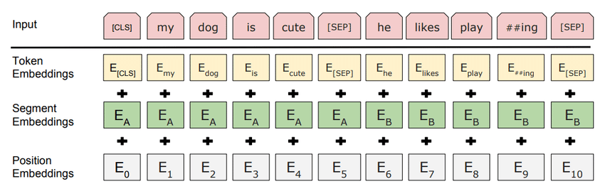
Sentiment classifier
The movie was awful. The actors underperformed. It had nice visual and sound effects but that was all. Bad scenario, bad performances, waste of time and money
Text and Tokens (CLS, SEP) are converted to a vector representation (BERT Tokenizer)
Example:
[CLS] The movie was awful. The actors would #under ##perform [SEP]
101 10 1098 93 21 10 32 123 23 384 102
1 1 1 1 1 1 1 1 1 1 1
Bert vectorizer/tokenizer
[CLS] sentence A [SEP] sentence B [SEP]
BERT pretrained language model
pooled output 768x1
sequence output
768 x Input size
Polarity classifier
positive/negative

Slide 54
Sentiment classifier
The movie was awful. The actors underperformed. It had nice visual and sound effects but that was all. Bad scenario, bad performances, waste of time and money
Text and Tokens (CLS, SEP) are converted to a vector representation (BERT Tokenizer)
Example:
[CLS] The movie was awful. The actors would #under ##perform [SEP]
101 10 1098 93 21 10 32 123 23 384 102
1 1 1 1 1 1 1 1 1 1 1
Transfer learning
BERT is pre-trained on wikipedia data
and fine-tuned in our sentiment analysis task
BERT parameters updated along with
polarity classifier’s parameters
Training only on task’s data would result in lower performance
Bert vectorizer/tokenizer
[CLS] sentence A [SEP] sentence B [SEP]
BERT pretrained language model
pooled output 768x1
sequence output
768 x Input size
Polarity classifier
positive/negative

Slide 55
How do models learn language?
The apple I ….. yesterday was juicy and tasty

Slide 56
How do models learn language?
The apple I ate yesterday was juicy and tasty

Slide 57
How do models learn language?
The apple I ate yesterday was juicy and …..

Slide 58
How do models learn language?
………….. I ate yesterday was juicy and tasty

Slide 59
How do models learn language?
The apple I ate yesterday was juicy and …..
………….. I ate yesterday was juicy and tasty
The apple I ….. yesterday was juicy and tasty
To perform a good guess it is easier to have context on the left and right

Slide 60
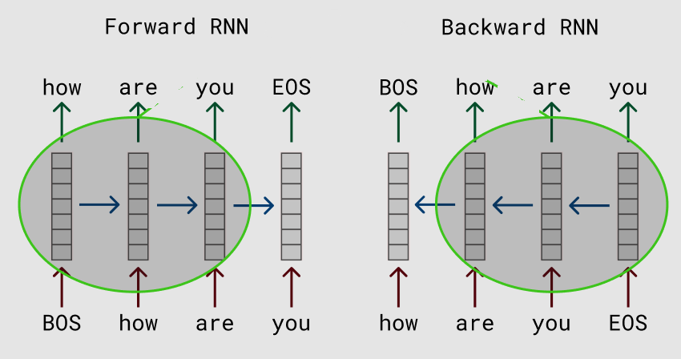
How do models learn language?
The apple I ate yesterday was juicy and …..
………….. I ate yesterday was juicy and tasty
In the bi-directional RNNs the backward model sees the word that the forward model needs to guess
Transformers: Positional encoding…
the network knows where the word is positioned in the text and learns to associate the prediction with the position of the word
Now it need to guess the MASK word not the next word
The apple I MASK yesterday was juicy and tasty

Slide 61

Attention: the last element of success

Slide 62

Attention: the last element of success

Slide 63
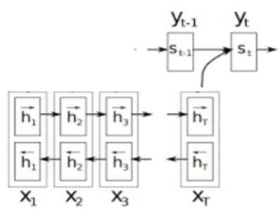
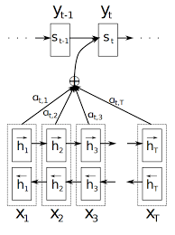
Attention: the last element of success
without attention
with attention

Slide 64
Let’s build with BERT a dialogue system …
User: Good morning Alexis..
System: Good morning what can I do for you?
User: Find a flight from Bilbao to Crete next Saturday at 15.00
Your Alexis system can perform the following
set the alarm
book a hotel, flight, restaurant
search on maps
Bert vectorizer/tokenizer
[CLS] sentence A [SEP] sentence B [SEP]
BERT pretrained language model
What would you change to the sentiment
model to make it a dialogue system?
pooled output 768x1
sequence output
768 x Input size
Polarity classifier
positive/negative

Slide 65
Let’s build with BERT a dialogue system …
User: Good morning Alexis..
System: Good morning what can I do for you?
User: Find a flight from Bilbao to Crete next Saturday at 15.00
Your Alexis system can perform the following
set the alarm
book a hotel, flight, restaurant
search on maps
Bert vectorizer/tokenizer
[CLS] Find a flight from Bilbao to Crete next Saturday at 15.00 [SEP]
BERT pretrained language model
What would you change to the sentiment
model to make it a dialogue system?
pooled output 768x1
sequence output
768 x Input size
Polarity classifier
positive/negative

Slide 66
Let’s build with BERT a dialogue system …
User: Good morning Alexis..
System: Good morning what can I do for you?
User: Find a flight from Bilbao to Crete next Saturday at 15.00
Your Alexis system can perform the following
set the alarm
book a hotel, flight, restaurant
search on maps
Bert vectorizer/tokenizer
[CLS] Find a flight from Bilbao to Crete next Saturday at 15.00 [SEP]
BERT pretrained language model
What would you change to the sentiment
model to make it a dialogue system?
pooled output 768x1
sequence output
768 x Input size
Domain classifier
book_a_flight

Slide 67
Let’s build with BERT a dialogue system …
User: Good morning Alexis..
System: Good morning what can I do for you?
User: Find a flight from Bilbao to Crete next Saturday at 15.00
Your Alexis system can perform the following
set the alarm
book a hotel, flight, restaurant
search on maps
Bert vectorizer/tokenizer
[CLS] Find a flight from Bilbao to Crete next Saturday at 15.00 [SEP]
BERT pretrained language model
What would you change to the sentiment
model to make it a dialogue system?
pooled output 768x1
O O O O B-from O B-to B-day_reference B-day O B-time
Training:
Find a flight from Bilbao to Crete next Saturday at 15.00
O O O O B-from O B-to B-day_ref B-day O B-time
B-from = Bilbao
B-to=Crete
B-day_ref = next
B-day=Saturday
B-time=15.00
Domain classifier
Prediction:
book_a_flight

Slide 68


Slide 69
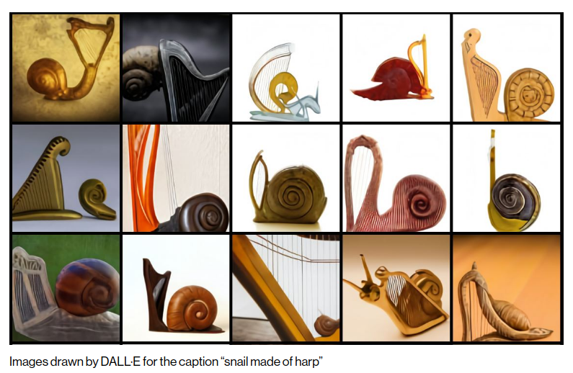

Slide 70
Stay tuned...
https://research.google/
https://huggingface.co/
Getting started
https://pytorch.org/tutorials/
https://keras.io/examples/

